Slide 1
PhD SYNOPSIS · BOARD OF ADVANCED STUDIES & RESEARCH (BASR)
A Leakage-Safe Framework for Observability-Aware Regression Testing of Quantum Compilers
Catching the transpiler regressions the standard output check cannot observe
Furqan Nasir
PhD in Computer Science
City University of Science & IT, Peshawar
July 2026
Notes:
First question, quauntum hardware is not available what is meant by quantum compilers? If you make it ready for compiler then how does you know that this is the bug or not. Forward pass backward pass

Slide 2
FOLLOWING THE PROPOSAL CHAPTERS
Outline
1
Introduction
2
Problem statement
3
Research questions & objectives
4
Literature review
5
Proposed methodology
6
Initial results
PhD Synopsis · A Leakage-Safe Framework for Observability-Aware Regression Testing of Quantum Compilers
2
Notes:
The talk follows the proposal chapters in order. No findings are shown until the initial-results section.
Key terms:
• Methodology — the planned, step-by-step way of carrying out the research
• Initial results — the study's initial findings

Slide 3
INTRODUCTION
What This Research Is About
▪ A quantum program must be rewritten to run on real hardware. In Qiskit, the “transpiler” does this rewriting. [8]
▪ The transpiler is updated very often, and any update can accidentally introduce a regression (a bug caused by a change). [1]
▪ A regression can give a wrong result, a lower-quality circuit, or slower compilation.
▪ We need regression testing that is trustworthy and affordable — catching these before they reach users.
PhD Synopsis · A Leakage-Safe Framework for Observability-Aware Regression Testing of Quantum Compilers
3

Slide 4
PROBLEM STATEMENT
The Problem
1. We can’t always observe the fault
2. We can’t afford to test everything
▪ The usual check, an output-equivalence oracle, looks only at the final output. [6]
▪ Some regressions keep the output correct but corrupt the transpiler’s internal state. [5]
▪ So the output-equivalence oracle cannot observe them — an observability gap.
▪ There are far too many tests to run them all on every update.
▪ Running everything each time is too slow and too expensive.
▪ We must select a small, high-value set — under a budget.
→ To our knowledge, no method yet combines matched oracles with budget-aware, leak-free test selection for the transpiler [26], [27], [42].
PhD Synopsis · A Leakage-Safe Framework for Observability-Aware Regression Testing of Quantum Compilers
4
Notes:
Give reference of last sentence there is no reliable and affordable way

Slide 5
RESEARCH QUESTIONS & OBJECTIVES
Research Questions
How often do real transpiler regressions fall into fault channels not detected by a reference regression screen comprising semantic-equivalence, compilation-validity, circuit-quality, and performance oracles?
RQ1
Can real transpiler regressions that evade this reference screen be shown, from source, to be detected by fault-class-matched contract, property, isolated-pass, or determinism oracles, demonstrating that the gap is real and closable?
RQ2
Can a leakage-safe, cost-aware regression-testing pipeline for the transpiler be built and shown operationally sound under an executable validity-gate audit?
RQ3
(a) At feasibility scale, does the pipeline run the transparent selector and all five baselines correctly under identical budgets and anti-leakage rules? (b) In the full study, once a precision-analysis-set number of forward-regression events is verified, does the selector front-load fault-detecting tests earlier than those baselines?
RQ4
PhD Synopsis · A Leakage-Safe Framework for Observability-Aware Regression Testing of Quantum Compilers
5
Notes:
The four research questions, worded as in the proposal. RQ1 and RQ2 concern the observability gap — how often regressions evade the reference screen, and whether a matched oracle catches one from source. RQ3 is the pipeline's operational soundness; RQ4 is the transparent selector versus baselines.

Slide 6
RESEARCH QUESTIONS & OBJECTIVES
Objectives
O1 → RQ1
O2 → RQ2
To measure how often real transpiler regressions fall into channels the reference screen (semantic-equivalence, compilation-validity, circuit-quality, and performance oracles) does not detect, by mining merged bug-fixes and classifying each channel with inter-rater agreement (Cohen's and Fleiss' κ).
To demonstrate, from source, at least one real regression that the reference screen misses but a fault-class-matched contract, property, isolated-pass, or determinism oracle detects, establishing that the gap is real and closable.
O3 → RQ3
O4 → RQ4
To build the leakage-safe, cost-aware methodology as an open prototype (cart) and show it operationally sound under a six-gate validity audit, verifying at least one forward regression from source.
(a) Establish the pipeline runs the selector and all five baselines correctly under identical anti-leakage rules and budgets; (b) commit to a powered comparison once a precision-analysis-set number of forward-regression events is verified — reporting the outcome either way.
PhD Synopsis · A Leakage-Safe Framework for Observability-Aware Regression Testing of Quantum Compilers
6

Slide 7
LITERATURE REVIEW
What Others Have Done
▪ Classical testing: how to pick and order tests under a time budget — well studied. [3], [4]
▪ Quantum testing: finding bugs and generating tests for quantum programs. [7], [23], [24]
▪ Equivalence checking: the standard “is the answer the same?” check — efficient and trusted. [6]
▪ Internal checks: CertiQ, Giallar, and concolic testing inspect compiler passes and internal state. [26], [27], [42]
The gap we fill:
▪ Others verify passes and inspect internal state (Giallar, CertiQ, concolic) — so internal observability is feasible. [27], [42], [26]
▪ But, to our knowledge, no study turns that into matched regression oracles with budget-aware, leak-free test selection for the transpiler [3], [14].
PhD Synopsis · A Leakage-Safe Framework for Observability-Aware Regression Testing of Quantum Compilers
7
Notes:
Where prior work sits: classical test selection and prioritisation; quantum testing (MorphQ, QDiff); equivalence checking; and internal-state verification (CertiQ, Giallar, concolic). The gap we fill is combining matched internal-observability oracles with budgeted, leakage-safe selection — which no prior work does.

Slide 8
LITERATURE REVIEW
How This Work Compares
Approach | Primary goal | QA oracle | Cost-aware | Selects / orders existing | Leakage-safe temporal | Cohort sep.
Classical RTP/TCP | prioritise tests of a program | ○ | ● | ● | ◐ | ○
Predictive selection | learned selection at scale | ○ | ● | ● | ● | ○
MorphQ / MorphQ++ | metamorphic bug finding | ● | ○ | ○ | ○ | ○
QuCheck | property-based testing | ● | ○ | ○ | ○ | ○
QEMI | EMI stack bug finding | ● | ○ | ○ | ○ | ○
QDiff | differential stack bug finding | ● | ○ | ○ | ○ | ○
QSPE | skeletal-program differential testing | ● | ○ | ○ | ○ | ○
Giallar | formal Qiskit-pass verification | ● | ○ | ○ | ○ | ○
Benchpress | SDK compilation benchmarking | ◐ | ○ | ○ | ○ | ○
This work | cost-aware test selection for the transpiler | ● | ● | ● | ● | ●
PhD Synopsis · A Leakage-Safe Framework for Observability-Aware Regression Testing of Quantum Compilers
8
Notes:
Table 2.1 compares this work with the closest prior threads across the properties that matter. Only this work has all of them together: a quantum-aware oracle, internal-state observability, cost-awareness, selection of existing tests, leakage-safe evaluation, and cohort separation.

Slide 9
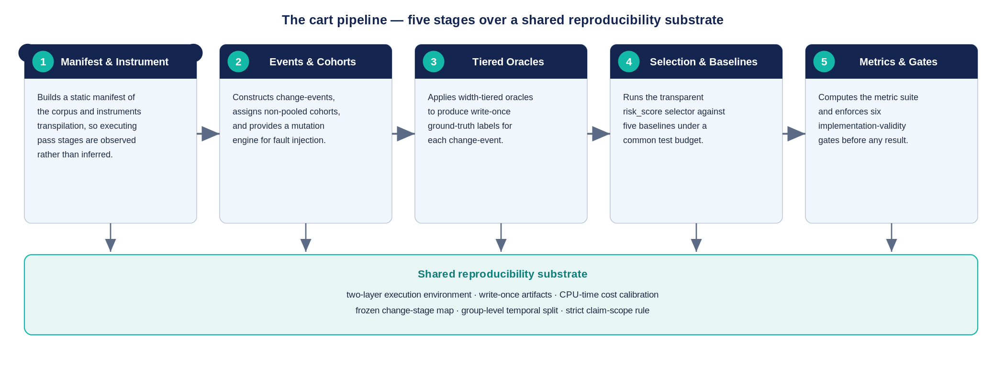
PROPOSED METHODOLOGY
The cart Pipeline
PhD Synopsis · A Leakage-Safe Framework for Observability-Aware Regression Testing of Quantum Compilers
9
Notes:
The cart pipeline in five stages over a shared reproducibility substrate — manifest and instrument; change-events and cohorts; tiered oracles producing write-once labels; selection against baselines under a budget; metrics and validity gates. Every result flows through the same audited substrate.

Slide 10
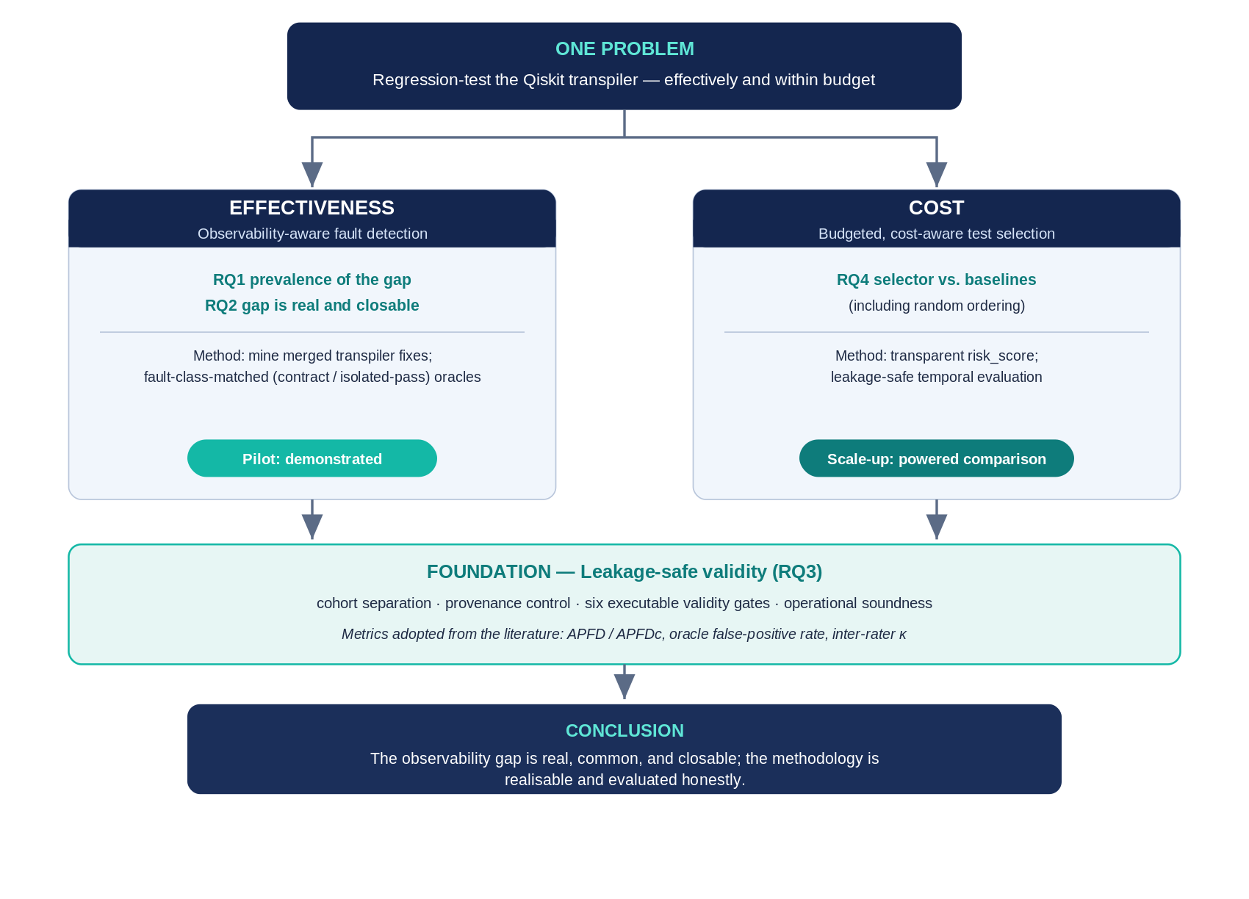
PROPOSED METHODOLOGY
Research Framework
PhD Synopsis · A Leakage-Safe Framework for Observability-Aware Regression Testing of Quantum Compilers
10
Notes:
Figure 3.2 — the whole research on one page. One problem splits into two goals: EFFECTIVENESS (observability-aware fault detection; RQ1 prevalence, RQ2 gap real and closable) and COST (budgeted, cost-aware selection; RQ4 selector vs baselines). Both rest on a FOUNDATION of leakage-safe validity (RQ3): cohort separation, provenance, and six validity gates. Every metric is taken from the regression-testing literature (APFD, APFDc, false-positive rate, inter-rater kappa) — none is invented. Honest scope: the study demonstrates the effectiveness side; the cost-effectiveness comparison is the scale-up phase.
Key terms:
• Effectiveness — does it catch the regressions, including the output-invisible ones.
• Cost — does it catch them within a test budget (APFD/APFDc).
• Leakage-safe validity — the evaluation never uses answer or future information; results are trustworthy.

Slide 11
PROPOSED METHODOLOGY
The Test Selector (risk_score)
risk_score = (ε + change_stage_match) × sensitivity × impact_prior × oracle_confidence ÷ expected_cost × novelty
▪ Transparent: hand-set weights, no black-box AI — every choice is explainable.
▪ Leakage-safe: it sees only pre-execution information; it never peeks at the outcome.
▪ Compared: against five simple baselines, including random ordering. [3], [14]
▪ Frozen: all weights are fixed before evaluation and checked by ablation.
PhD Synopsis · A Leakage-Safe Framework for Observability-Aware Regression Testing of Quantum Compilers
11
Notes:
The transparent selector is a hand-set, explainable scoring rule — no black-box AI. It uses only pre-execution information, is compared against five baselines including random, and its weights are frozen before evaluation and checked by ablation and a global sensitivity analysis.

Slide 12
INITIAL RESULTS
What We Tested
▪ Run on a single ordinary laptop, using circuits of up to eight qubits.
▪ A set of quantum circuits of different types, up to eight qubits.
▪ We ran the whole regression-testing pipeline end to end.
▪ We also reproduced real historical transpiler regressions from Qiskit’s own history.
PhD Synopsis · A Leakage-Safe Framework for Observability-Aware Regression Testing of Quantum Compilers
12
Notes:
The evaluation runs on a single ordinary laptop, on circuits of up to eight qubits, across several circuit types, end to end, and reproduces real historical transpiler regressions from Qiskit's own development history.

Slide 13
INITIAL RESULTS
Pipeline Feasibility: Validity Gates
Implementation-validity gate | Result
Budget compliance | PASS
Reproducibility (same seed ⇒ same ranking) | PASS
Leakage absence (current-event outcome cannot change ranking) | PASS
Label reproducibility from write-once artifacts | PASS
Metric correctness vs hand-computed cases | PASS
Oracle coverage | PASS
PhD Synopsis · A Leakage-Safe Framework for Observability-Aware Regression Testing of Quantum Compilers
13
Notes:
All is pass but how

Slide 14
INITIAL RESULTS
Historical Transpiler Regressions Attempted
Event (PR) | Cohort | Fault type ->channel | Status
H4 (#14120) | forward_regression | Performance | verified (multi-run protocol)
H1 (#14603) | fix_boundary | semantic ->contract/metadata | demonstrated gap (output-unobservable)
H2 (#14919) | fix_boundary | semantic -> contract/metadata | not run
H3 (#14730) | fix_boundary | quality -> determinism | blocked (needs noisy target)
H5 (#16285) | fix_boundary | functional -> compilation_failure | not run (input-specific crash)
PhD Synopsis · A Leakage-Safe Framework for Observability-Aware Regression Testing of Quantum Compilers
14
Notes:
Five real historical transpiler regressions attempted from source. Two produced positive findings; the others are reported honestly as blocked or not run on commodity hardware.

Slide 15
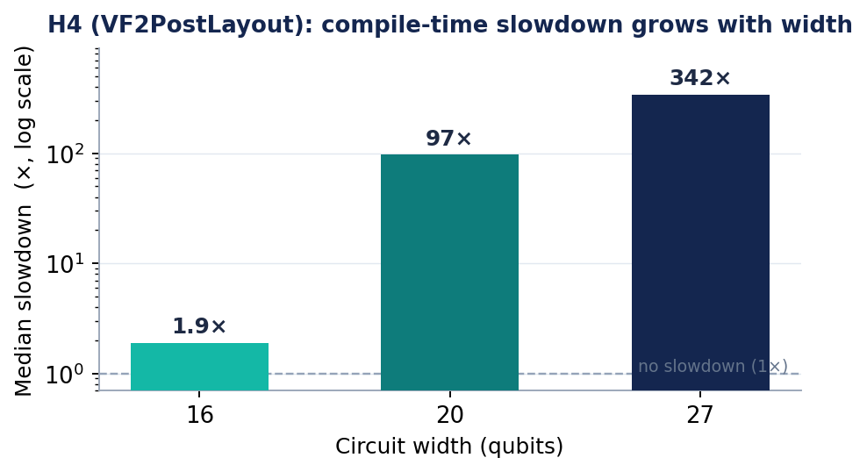
INITIAL RESULTS
H4 — A Verified Performance Regression
H4’s width-extended run (16–27 qubits) is a separate regime from the primary corpus (≤ 8 qubits).
PhD Synopsis · A Leakage-Safe Framework for Observability-Aware Regression Testing of Quantum Compilers
15
Notes:
H4 — a real update made compilation dramatically slower at larger width. Because the slowdown only appears at width, it was measured on a separate 16–27-qubit regime by timing the compiler, which needs no simulation and no hardware.

Slide 16
INITIAL RESULTS
H1 — The Observability Gap on a Real Regression
Oracle | Result on the buggy build
Black-box output-equivalence | EQUIVALENT (fault missed)
Property / isolated-pass (matched) | contract_metadata_fail (fault detected)
PhD Synopsis · A Leakage-Safe Framework for Observability-Aware Regression Testing of Quantum Compilers
16
Notes:
H1 — the same real regression shown to two oracles: the reference screen reports EQUIVALENT and misses it, while the matched contract oracle detects the corrupted layout metadata. This is the observability gap, demonstrated on a real regression.

Slide 17
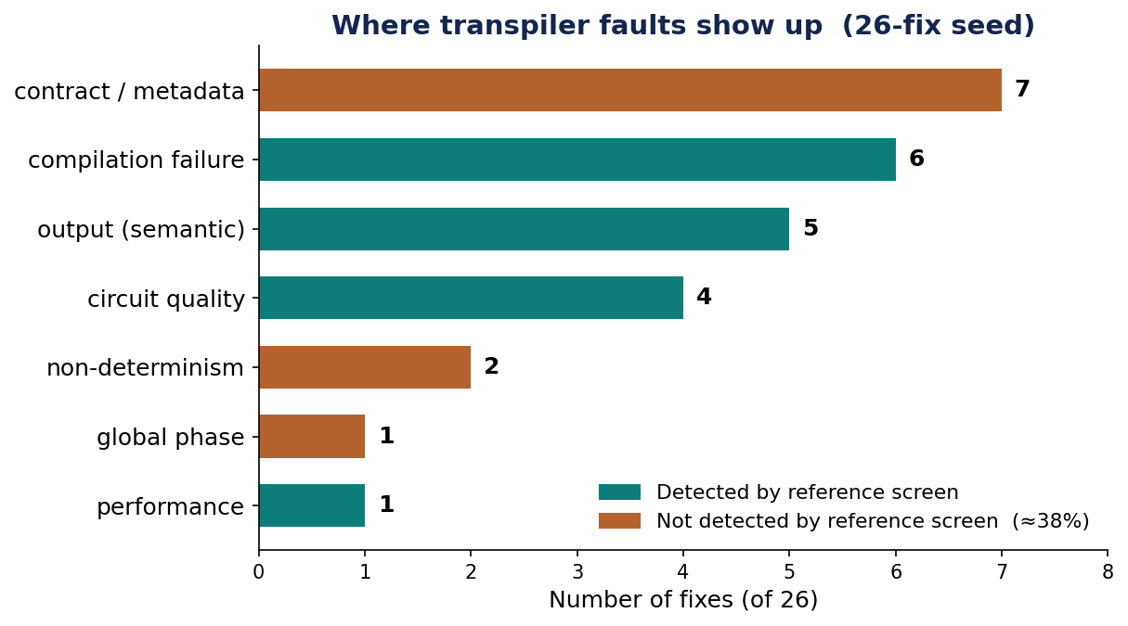
INITIAL RESULTS
Preliminary Oracle-Observability Gap in the 26-Fix Seed
“Invisible” = not detected by the semantic (unitary-equivalence), quality, performance, or compilation screen — i.e. contract/metadata, non-determinism, and operationally-relevant global phase. Purposive seed of 26 fixes; full mining is future work.
PhD Synopsis · A Leakage-Safe Framework for Observability-Aware Regression Testing of Quantum Compilers
17
Notes:
You are working on which one. Circuit quality is already done so why you are working

Slide 18
ONE YEAR TO COMPLETION
Work Plan
Phase 1
Feasibility study (methodology, prototype, initial results)
Completed
Phase 2
Scale-up: verify ≥ 3 forward regressions; expand mining
2026 Q3
Phase 3
Comparison: selector vs baselines
2026 Q4
Phase 4
Validation and cross-SDK generalisation
2027 Q1
Phase 5
Thesis write-up and defence
2027 Q2
PhD Synopsis · A Leakage-Safe Framework for Observability-Aware Regression Testing of Quantum Compilers
18
Notes:
The one-year work plan. Phase 1 is complete; the remaining phases scale up, run the powered comparison, validate and extend to other tools, and finish with write-up and defence.
Key terms:
• Powered comparison — a study with enough samples to draw statistically reliable conclusions
• Cross-SDK generalisation — extending the approach to other quantum toolkits beyond Qiskit
• Mining — collecting real bug-fixes from project history to expand the dataset

Slide 19
SUMMARY
Where We Stand
▪ The prototype is feasible and has produced usable evidence on two real historical regression events.
▪ One real contract regression (H1) shows the reference screen can miss a fault a matched oracle detects.
▪ The 26-fix seed indicates a potentially material gap; full mining and the comparative selector evaluation remain future work.
Thank you — Questions & discussion

Slide 20
REFERENCES
Selected References
[1] Paltenghi & Pradel. Bugs in quantum computing platforms: an empirical study. OOPSLA, 2022.
[3] Yoo & Harman. Regression testing minimization, selection and prioritisation: a survey. STVR, 2012.
[4] Machalica et al. Predictive test selection. ICSE-SEIP, 2019.
[5] Paltenghi & Pradel. A survey on testing and analysis of quantum software. arXiv, 2024.
[6] Burgholzer & Wille. Advanced equivalence checking for quantum circuits. IEEE TCAD, 2021.
[7] Paltenghi & Pradel. MorphQ: metamorphic testing of the Qiskit platform. ICSE, 2023.
[8] Javadi-Abhari et al. Quantum computing with Qiskit. arXiv, 2024.
[14] Elsner et al. Readily available information for regression test optimization in CI. ISSTA, 2021.
[22] Pontolillo et al. QuCheck: property-based testing for Qiskit. arXiv, 2025.
[23] Luo et al. QEMI: testing quantum stacks via equivalence modulo inputs. FASE, 2026.
[24] Wang et al. QDiff: differential testing of quantum software stacks. ASE, 2021.
[25] Ye et al. QSPE: enumerating skeletal quantum programs. arXiv, 2026.
[26] Choudhury et al. Concolic testing for quantum compilers. IEEE ICCD, 2025.
[27] Tao et al. Giallar: push-button verification for the Qiskit compiler. PLDI, 2022.
[42] Shi et al. Contract-based verification of a realistic quantum compiler (CertiQ). arXiv, 2019.
[46] Oldfield et al. Faster & better quantum software testing. ACM TOSEM, 2025.
[47] Kang, Lee & Oh. Statistical testing of quantum programs. OOPSLA, 2024.
[48] Lee, Hong & Ryu. Exact inference for quantum circuits. ASE, 2025.
[50] Burgholzer, Raymond & Wille. Verifying results of the IBM Qiskit compilation flow. QCE, 2020.
[51] Ali et al. Input/output coverage criteria for testing quantum programs. ICST, 2021.
[52] Wang et al. QuSBT: search-based testing of quantum programs. ICSE-C, 2022.
[53] Klimis et al. Shaking up quantum simulators with fuzzing and rigour. OOPSLA, 2025.
[54] Mei et al. Equivalence checking via path-sum & weighted model counting. TACAS, 2026.
[55] Ye et al. Is measurement enough? Rethinking output validation in quantum program testing. ASE (NIER), 2025.
Numbering follows the proposal's reference list.

Slide 21
BACKUP — FOR QUESTIONS
Classical Foundation vs. Quantum-Specific Need
Dimension | Classical testing | Quantum transpiler
Observed result | Deterministic, directly inspectable | Probabilistic samples; internal state not directly observable
Correctness | Equality / observational equivalence | Up to global phase & qubit/layout permutation
Fault model | Crashes, wrong values, performance | + phase, entanglement, mapping/routing, backend/noise
Execution cost | Repeatable CPU time; one run | Repeated shots; simulation growth; oracle cost
Regression oracle | Expected output, assertions, logs | Output equivalence alone misses metadata/layout/quality
Foundation | Selection, prioritisation, cost, APFD/APFDc | Retained — but features, costs, oracles redefined
Classical principles are the foundation; they do not transfer unchanged — this work is a quantum-specific adaptation and empirical validation, not the invention of regression testing.
PhD Synopsis · A Leakage-Safe Framework for Observability-Aware Regression Testing of Quantum Compilers
21

Slide 22
BACKUP — FOR QUESTIONS
Evidence: Why Quantum Differs
▪ 39.9% of real quantum-platform bugs are quantum-specific — concentrated in compile/optimise components — a classical fault model is incomplete [1].
▪ Quantum outputs are exponentially large distributions — conventional distribution testing can miss phase-flip faults [46].
▪ State equivalence can’t be read from one observation — assurance needs repeated measurement; specialised oracles expose non-crash bugs [47], [48].
▪ Equivalence checking had to be redesigned — for reversibility, superposition, entanglement — not reused from classical [6].
▪ Compiler-pass reasoning must encode quantum semantics — formal verification confirms this is necessary and feasible [27].
Central claim: classical machinery does not directly solve quantum-transpiler regression testing — its observability, oracle, equivalence and cost models do not hold unchanged.
PhD Synopsis · A Leakage-Safe Framework for Observability-Aware Regression Testing of Quantum Compilers
22

Slide 23
BACKUP — FOR QUESTIONS
How Do We Evaluate Something Novel?
The method is new — the evaluation apparatus is entirely standard. We do not compare against a non-existent rival; we do what every regression-testing study does:
▪ Established baselines: the selector is compared against random ordering plus cost-, history-, coverage/diversity- and change-based heuristics — the field-standard set [3], [10], [14].
▪ Standard metrics: APFD and cost-cognizant APFDc, recall@budget, detection-vs-budget AUC, oracle false-positive rate, inter-rater κ — all from the literature [10], [12], [40], [41].
▪ Real ground truth: evaluation on real, historical Qiskit regressions where the correct answer is known — e.g., a bug the output oracle passed but the matched oracle caught.
▪ Ablation: quantum-specific components are switched off one at a time to show which actually carry the effect — the method is compared against reduced versions of itself.
▪ Self-audit: six leakage-safe validity gates make every result reproducible and trustworthy, independent of any competitor.
▪ Unit of analysis: the regression event is the independent unit; test–oracle pairs are nested observations, not independent replications.
In one line: what is new is the method; the yardstick — baselines, metrics, and real bugs — is standard and cited.
PhD Synopsis · A Leakage-Safe Framework for Observability-Aware Regression Testing of Quantum Compilers
23

Slide 24
BACKUP — FOR QUESTIONS
Where the Tested Regressions Come From
The events (e.g., H1 = PR #14603, H4 = PR #14120) are not “just GitHub” — for an open-source SDK the repository IS the authoritative primary record.
▪ Canonical primary source: merged pull requests, their linked issues, and release notes are the official record of what changed and why — permanent and citable.
▪ Standard methodology: mining merged bug-fix commits is established empirical-software-engineering practice [49] (the SZZ / Mining-Software-Repositories line).
▪ Same source as accepted benchmarks: Bugs4Q curates real Qiskit bugs from this history [29]; Paltenghi & Pradel mined 223 real platform bugs the same way [1].
▪ Full traceability: each event → inducing/fixing PR + issue thread + release note; all IDs, revisions and build scripts released for reproduction.
▪ Why not RFCs: Qiskit RFCs cover major design changes, not routine bug fixes — those live in the PR + release-note record, which is the correct provenance.
Every tested regression is traceable to a permanent, verifiable record — more so than most secondary sources.
PhD Synopsis · A Leakage-Safe Framework for Observability-Aware Regression Testing of Quantum Compilers
24

Slide 25
BACKUP — FOR QUESTIONS
Do We Run Quantum Simulations? (No Hardware)
Yes — classical simulation only, on the CPU. A simulator is classical software that computes what a quantum device would do; it never needs a quantum device.
▪ What we test is classical: the transpiler is compiler software; checking its output is a classical computation, not a physics experiment.
▪ How the check runs: for small circuits (≤ 12 qubits) we compute the exact unitary with linear algebra (Qiskit’s classical simulator) and compare up to global phase [6].
▪ It runs on a laptop: the corpus uses up to 8 qubits, so every semantic check simulates in milliseconds on a 32 GB CPU — no device, no queue, no noise.
▪ Where simulation would blow up: above the cap we do NOT simulate — structural checks (basis + coupling-map) take over, and even the 27-qubit performance test only times the compiler, not the circuit's output.
▪ No hardware on the critical path: our research validates the compiler transformation, not physical execution — it stops one step before hardware is needed. Physical-noise fidelity is a separate, downstream question, out of scope.
Simulator ≠ hardware: it runs on an ordinary CPU. Exact simulation is exponential, so the design caps it and falls back — that is why no quantum device is needed.
PhD Synopsis · A Leakage-Safe Framework for Observability-Aware Regression Testing of Quantum Compilers
25

Slide 26
BACKUP — FOR QUESTIONS
Precedent: Testing Quantum Compilers Without Hardware
Top-venue studies evaluate quantum compilers and quantum-software testing in classical software or simulation — none required a QPU.
Study | Venue (year) | Tier | Ran on | QPU?
Giallar [27] | PLDI 2022 | A* | symbolic pass verification (classical) | No
VOQC [44] | POPL 2021 | A* | Coq proofs over circuit semantics | No
Burgholzer et al. [50] | IEEE QCE 2020 | Nat. | equivalence checking of Qiskit compilation | No
MorphQ [7] | ICSE 2023 | A* | Qiskit simulator (8,000+ program pairs) | No
Muskit [30] | ASE 2021 | A* | Qiskit software (mutation analysis) | No
Bugs4Q [29] | ASE 2021 | A* | Qiskit buggy/fixed revisions | No
QMutPy [31] | IEEE TQE 2022 | Q1 | Qiskit software (24 programs) | No
Coverage criteria [51] | ICST 2021 | A | simulator + statistical oracles | No
QuSBT [52] | ICSE-C 2022 | A* | Qiskit as the simulation framework | No
Simulator fuzzing [53] | OOPSLA 2025 | A* | Qiskit/Cirq simulators (800,000+ circuits) | No
Exact inference [48] | ASE 2025 | A* | classical exact inference oracle | No
Tier — conferences: CORE 2023 (A* = top tier, A = strong); journals: Scimago quartile (Q1 = top 25%). IEEE QCE is a specialised quantum venue (CORE national tier).
Our study is in exactly this established, hardware-free mode — evaluating the compiler transformation, not physical execution.
PhD Synopsis · A Leakage-Safe Framework for Observability-Aware Regression Testing of Quantum Compilers
26

Slide 27
BACKUP — FOR QUESTIONS
Which Oracle Detects Which Fault?
No single oracle covers all channels — each fault channel needs its matched oracle. “Output oracle” is not one thing.
Manifestation | Unitary equiv. | Compilation | Quality | Performance | Contract | Determinism
Semantic difference | Yes | Sometimes | No | No | No | No
Compilation failure | N/A | Yes | No | No | No | No
Circuit-quality regression | No | No | Yes | No | No | No
Performance regression | No | No | No | Yes | No | No
Contract/metadata corruption | No | No | No | No | Yes | Sometimes
Non-determinism | Not in 1 run | No | Sometimes | Sometimes | Sometimes | Yes
Contract and determinism channels are not covered by the reference black-box regression screen; the framework operationalises matched checks for them — and we demonstrate that a matched contract oracle can close the gap for H1.
PhD Synopsis · A Leakage-Safe Framework for Observability-Aware Regression Testing of Quantum Compilers
27

